Slide 1

OFFICE FLOW
DIH BRIDGE PROGRAM GRADUCATION PROJECT
Team members :
Elia Mamdouh
Rawan El Ashmawy
Engy Sameh
Sama Samy
Omar Adel
Date: August 23,2024

Slide 2

Today's Agenda
I. Introduction to the app | II. Problem Statement and its solution
III. Tools and Methodologies Used | IV. Features that OfficeFlow Offers
V. Live Demo for OfficeFlow | VI. Future Updates

Slide 3
Introduction to Our APP!
What How Who

Slide 4
Problem Statement
Problem Statement
In this section we will talk about the problems that our application solves
Schedule management
Adjusting WFH days
Manager-employee communication

Slide 5
Proposed Solutions
Proposed Solutions that our app solved
we decided to propose a solution that will do the following
Schedule management
Request tracking
Dynamic communication

Slide 6



Tools and Technologies
Front End:
Android Studio

Slide 7










Tools and Technologies
2.Back-End: 3.Other Services:

Slide 8
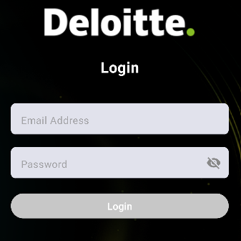
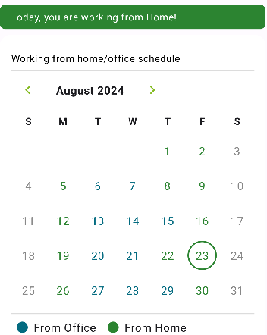
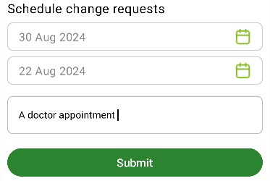
Features that OfficeFlow Offers
In this section we will show what our application offers to stand out!
Modern and Secure way
Fast and Unique to log into the App
access to your calendar Easy and efficient . way to submit a request

Slide 9
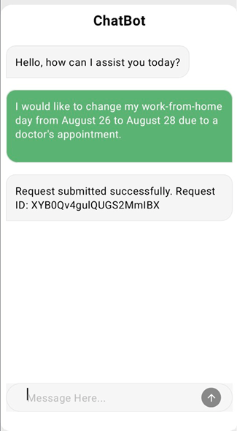
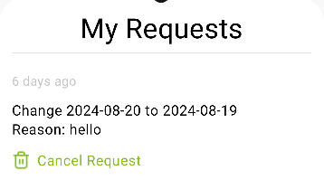
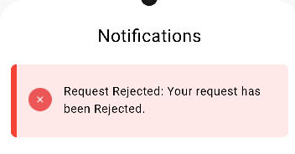
Features that OfficeFlow Offers
In this section we will show what our application offers to stand out!
Smart and Interactive
Chatbot system
Simplified way for
Tracking your Request
Easy and Accessible
Notification system

Slide 10
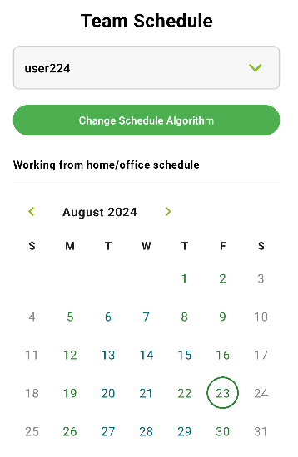
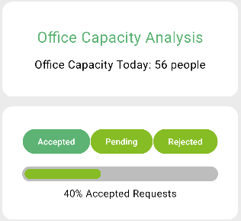
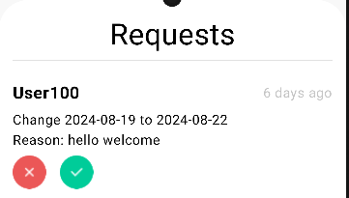
Features that OfficeFlow Offers
In this section we will show what our application offers to stand out!
Collaborative and adaptive
Viewing team schedule
Dynamic and Data-driven
Analytics screen Strealined and responsiveway for . the manager to accept requests

Slide 11






OUR FUTURE
UPDATES
Integrate the system where manager can give employees feedback on their work
Handle leave requests, time off, and vacation days to create a one-stop shop.
Sync with personal calendars
Integrate with existing HR and payroll systems.

Slide 12

LET US SHOW YOU A LIVE DEMO
OF OUR APPLICATION!

Slide 13
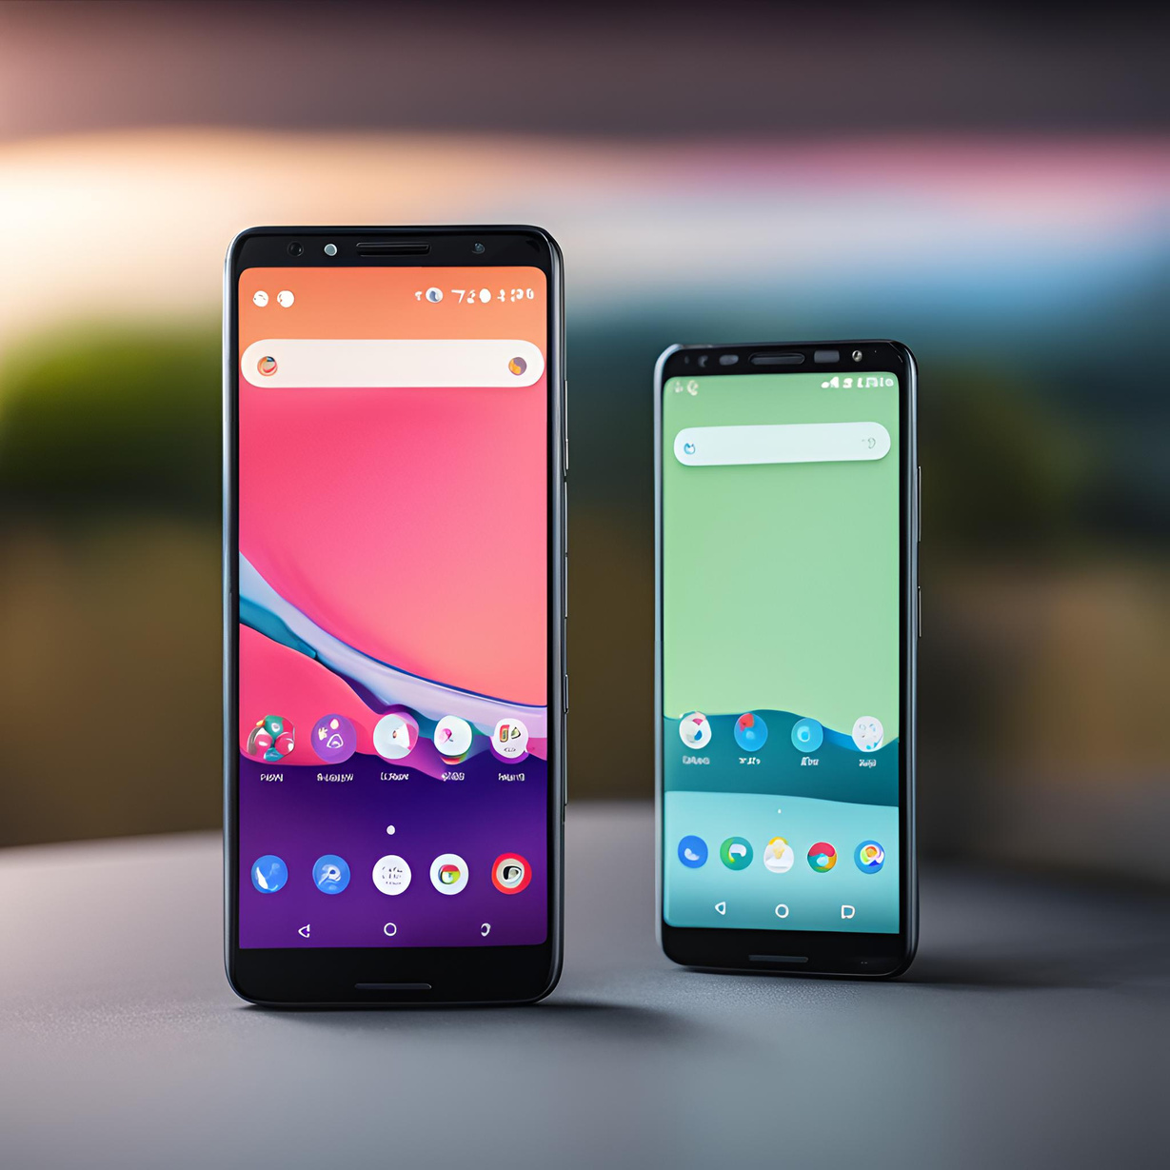
Thank you!
For taking the time to be a part of our presentation

